Slide 1

Beyond the Leak: High-Fidelity CFD Analysis of Hydrogen Transport Phenomena
Vladislav Kastrov
Roel Jansen
Notes:
Clearly explain what we mean with Transport Phenomena: we mean the physics of hydrogen transport after leak

Slide 2




Project Partners
Notes:
We would like to thank SEECE for financing this research via Seed grant. We hope it will lead to follow up.

Slide 3
Purpose of the project
Increase awareness regarding hydrogen dispersion phenomena to improve safety
Gain experience for future projects
Validate installation in the new Lab
Notes:
Explain about motivation: safety, hydrogen has low explosion limit, and its energy for ignition is extremely low. Could be written as point. Explain 4% lel
Mention increase in knowledge, all this is suggestion
Mention: hardly any research is known in which CFD models were validated against measurements with hydrogen.

Slide 4
Project objective
“Performance of CFD simulations, experimental validation, and analytical modelling of hydrogen dispersion in an enclosure.”
Notes:
Picture not needed

Slide 5
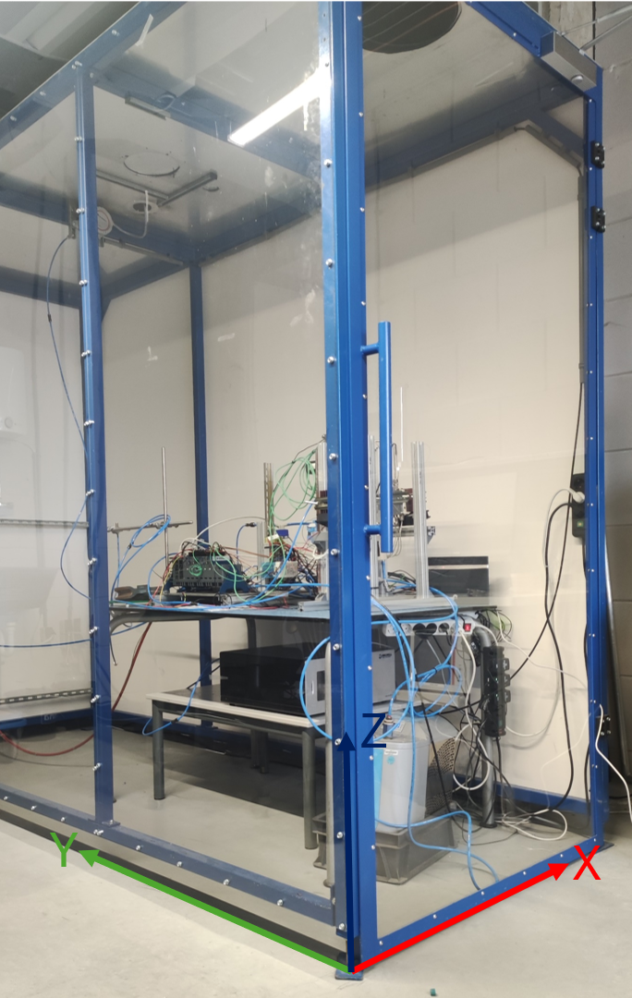
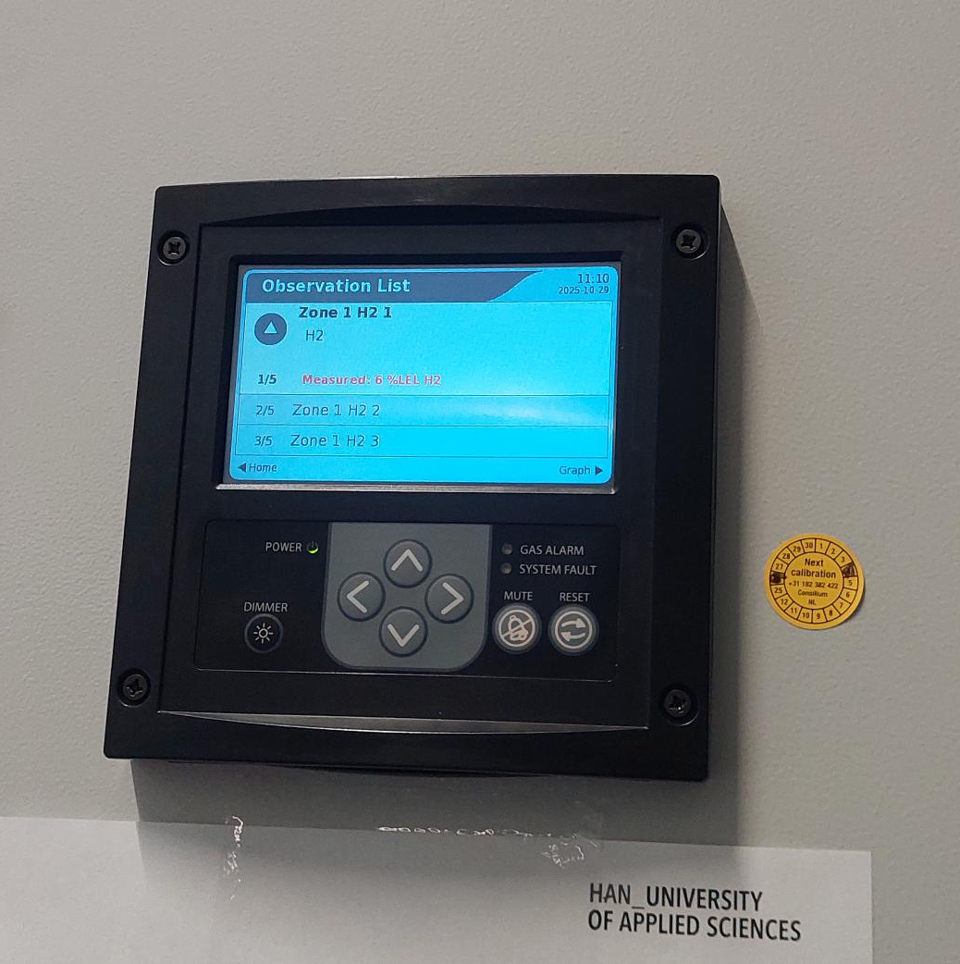
Hardware
Test cabin
Volume = 8.64 m³
Hydrogen outlet at x = 61, y = 187, z = 108 cm
Sample point at x = 53, = 194, z = 227 cm
Hydrogen alarm
Ventilation turned off

Slide 6
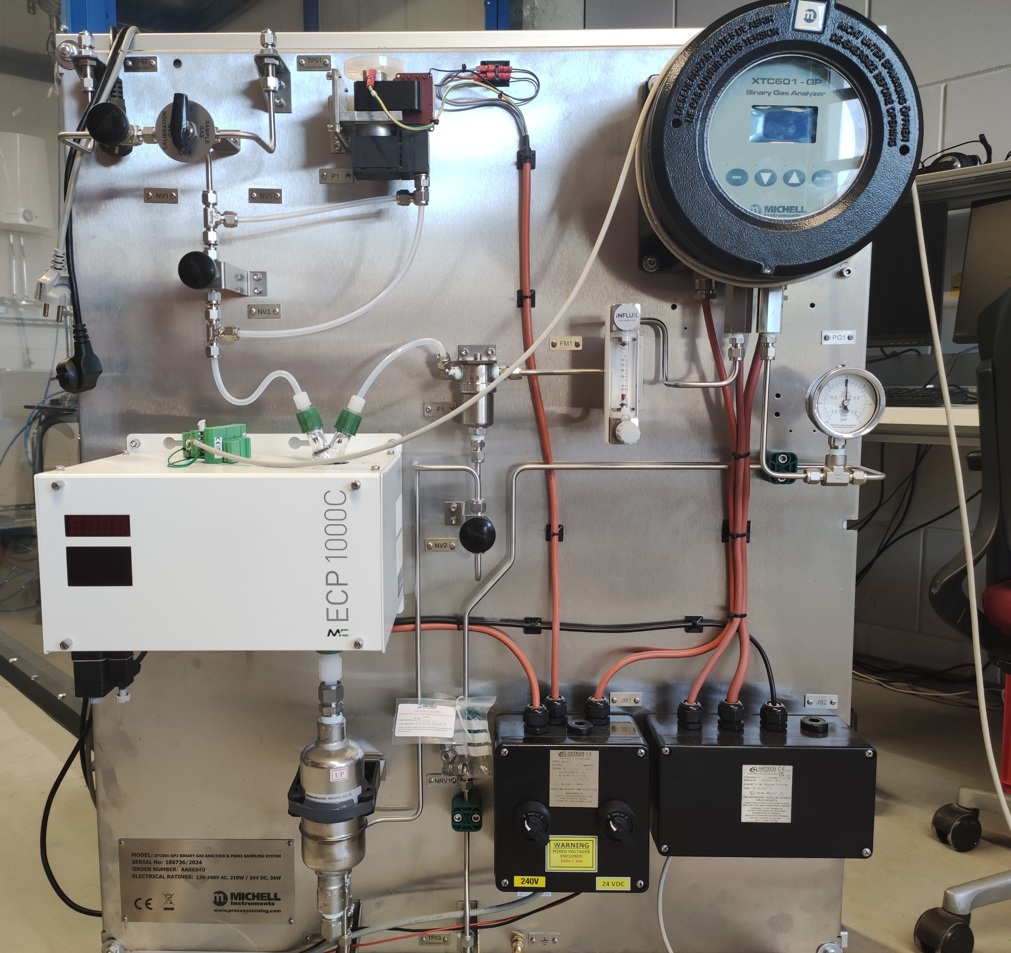
Hardware
Analyser
ATEX rated
Flow: 300 mln/min ± 10%
Thermal conductivity sensor
0 – 5% range H₂ in O₂
0-point calibrated
Accuracy better than ±1% full scale
Repeatability ±0.2% of range
Response time (T90) < 20 sec H₂)
Dead time entire system ~ 30-60 sec, depending on experiment
Notes:
You cannot measure concentration because we sample a volume, not a point
dead time was measured via impuls
Mention that thermal conductivity of air vs oxygen is highly similar since thermal conductivity of main constituent i.e. nitrogen is similar to that of oxygen

Slide 7
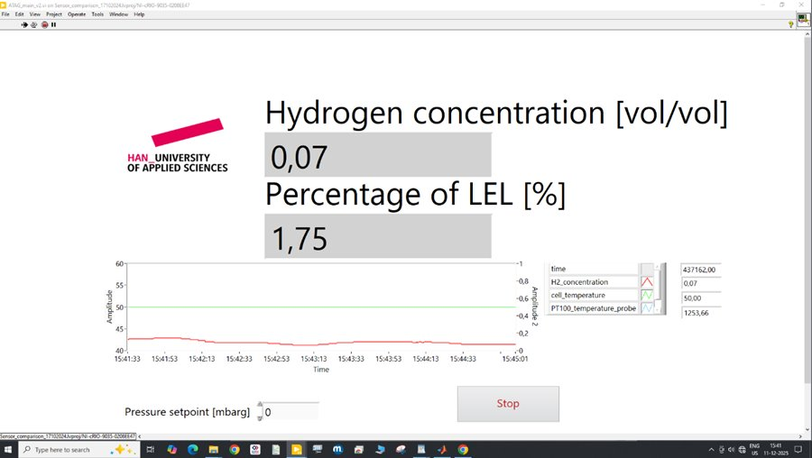
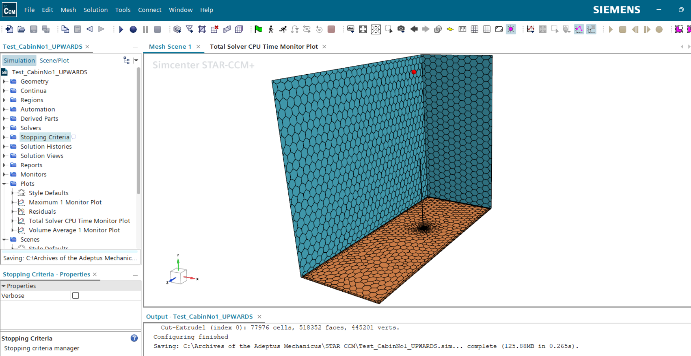
Software
Siemens STAR CCM v2506
LabVIEW v2023
MATLAB R2025a
Notes:
Mention that STAR CCM is based on CAD geometry, which is different from traditional approach like HyRAM

Slide 8
Research cases
1 ln/min flow upwards
2 ln/min flow upwards
2 ln/min flow downwards
2 ln/min flow sidewards

Slide 9
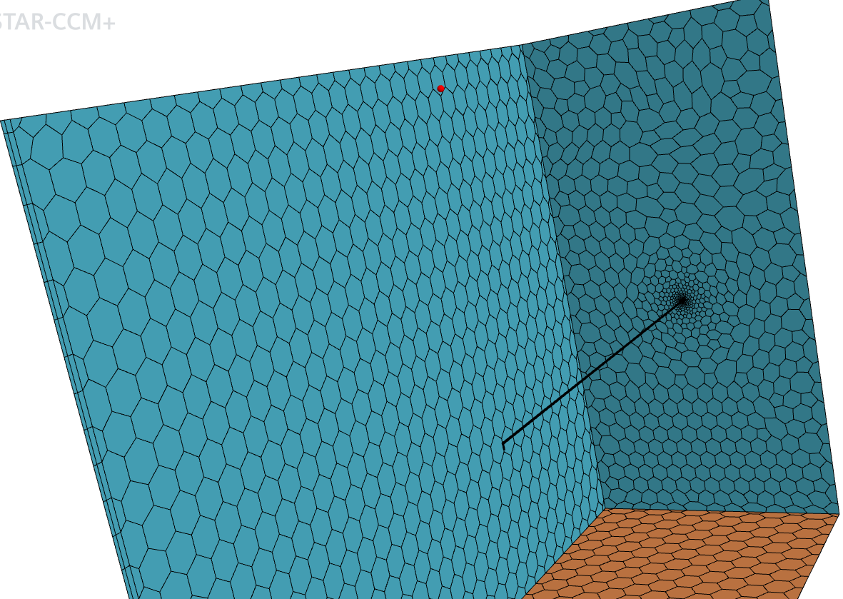
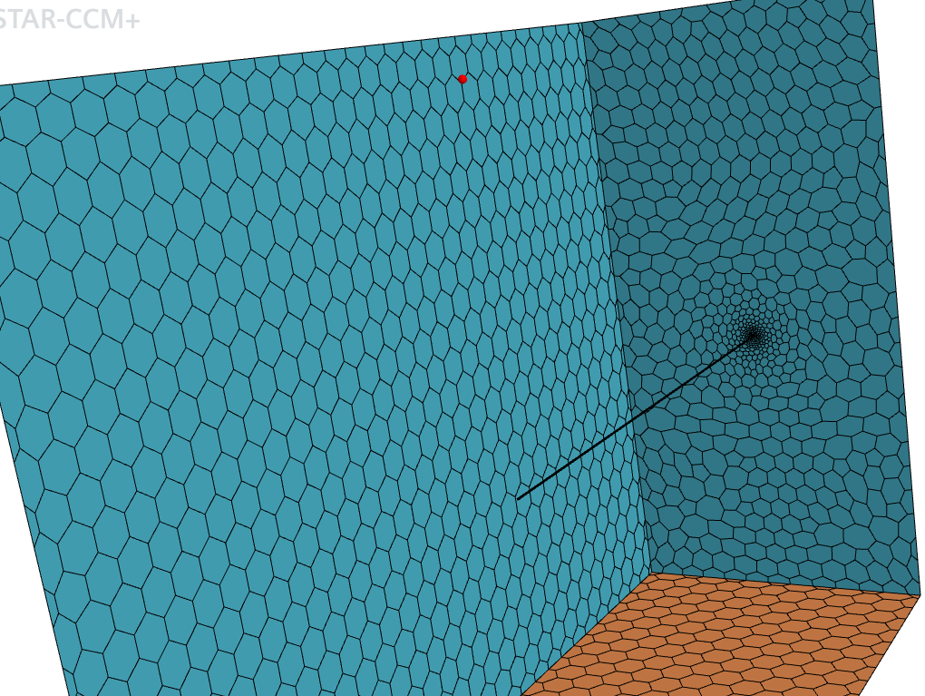
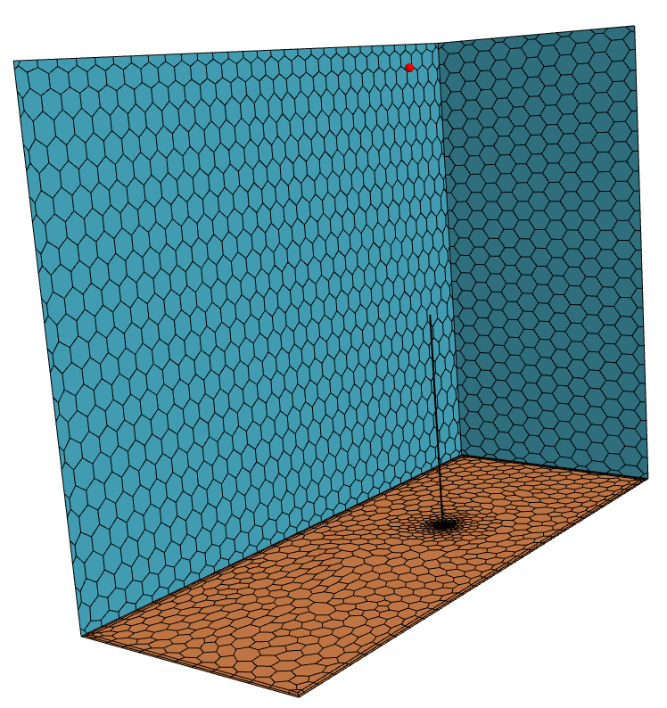
Simulation models
Notes:
Use either pointer, or use pointer option from powerpoint itself
Or use arrows on this slide,

Slide 10
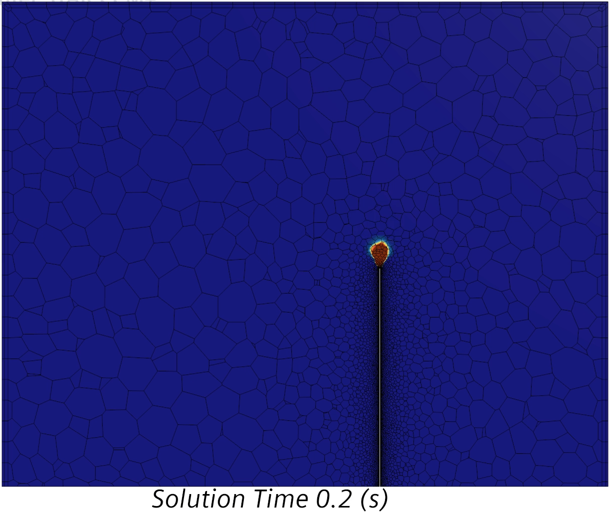

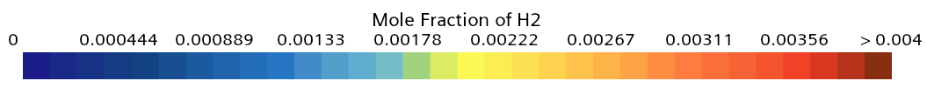
Dispersion for flow
Notes:
explain, the two dominant forces: buoyancy and momentum

Slide 11
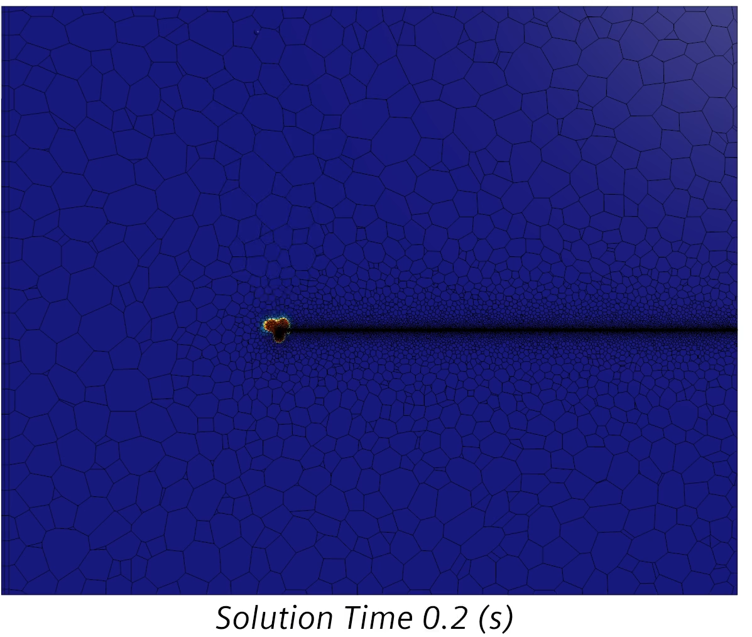
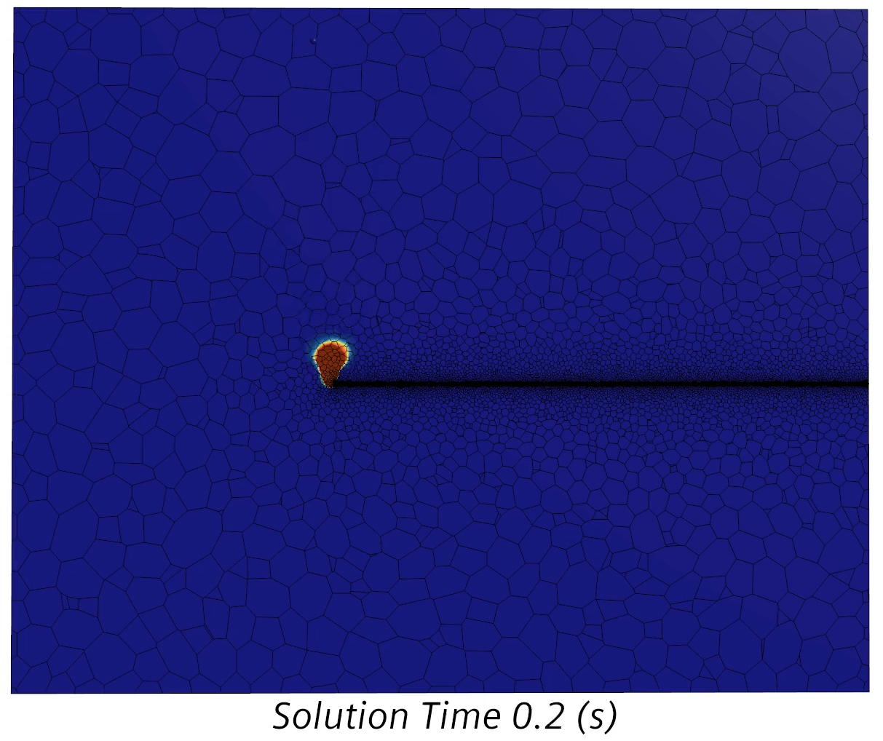
Dispersion for directions

Slide 12
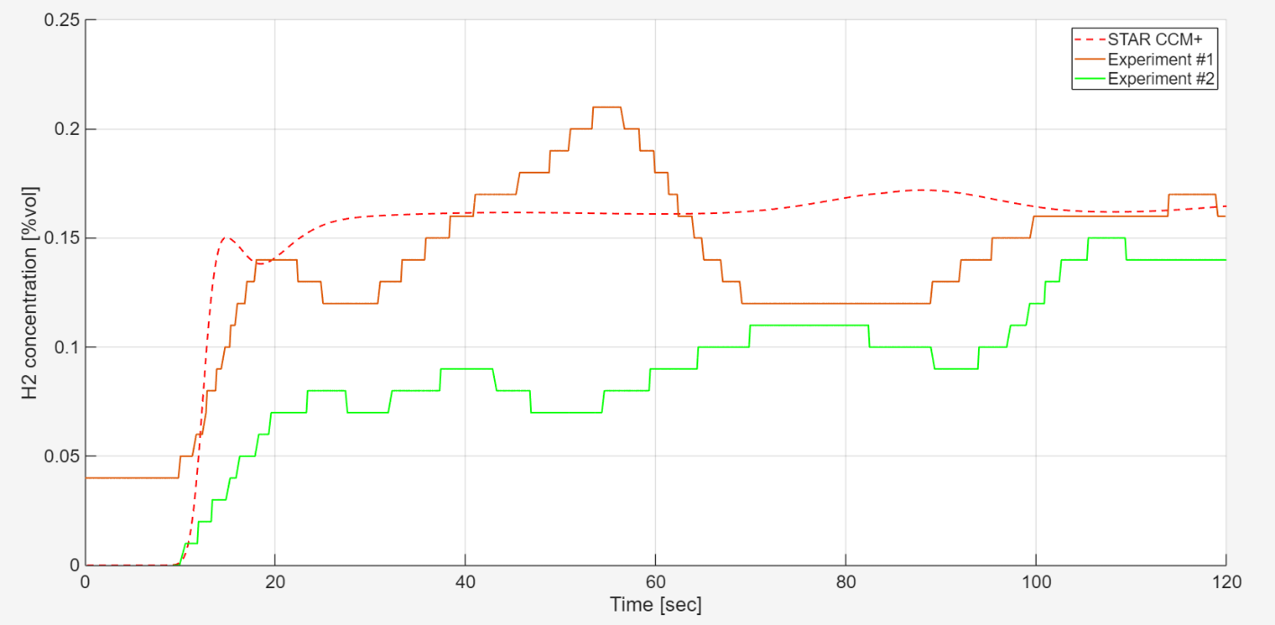
1 ln/min flow upwards
Notes:
Shift via change in concentration
1 ln/min flow upwards
0.4 = 10% of LEL = explosion limit

Slide 13
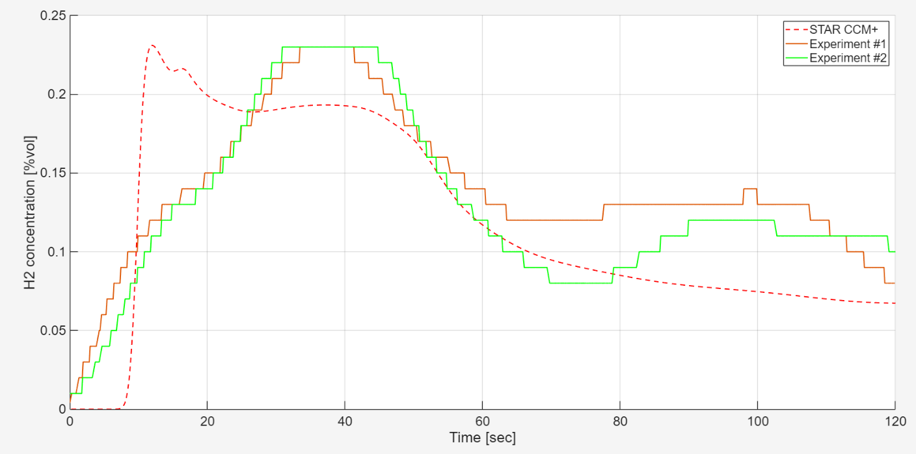
2 ln/min flow upwards
Notes:
Edit title
Data not shifted!

Slide 14
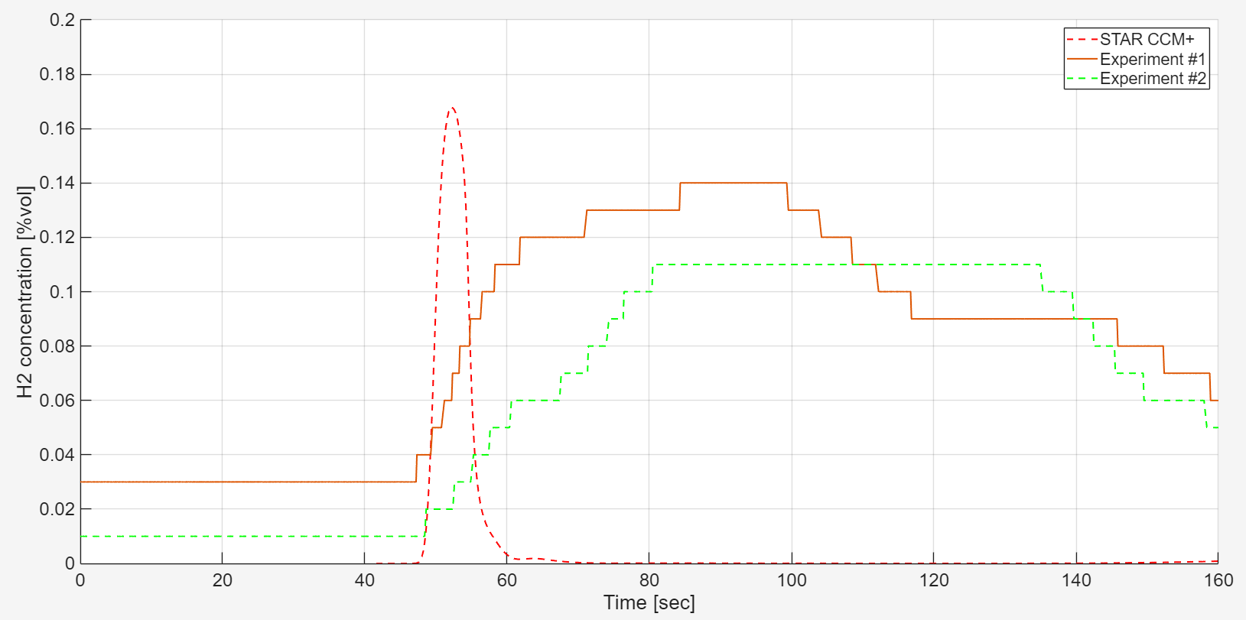
2 ln/min flow downwards
Notes:
Long piping between suction point and analyser, there is time needed to travel from suction point to sensor.
Edit title
Data shifted according to start of change

Slide 15
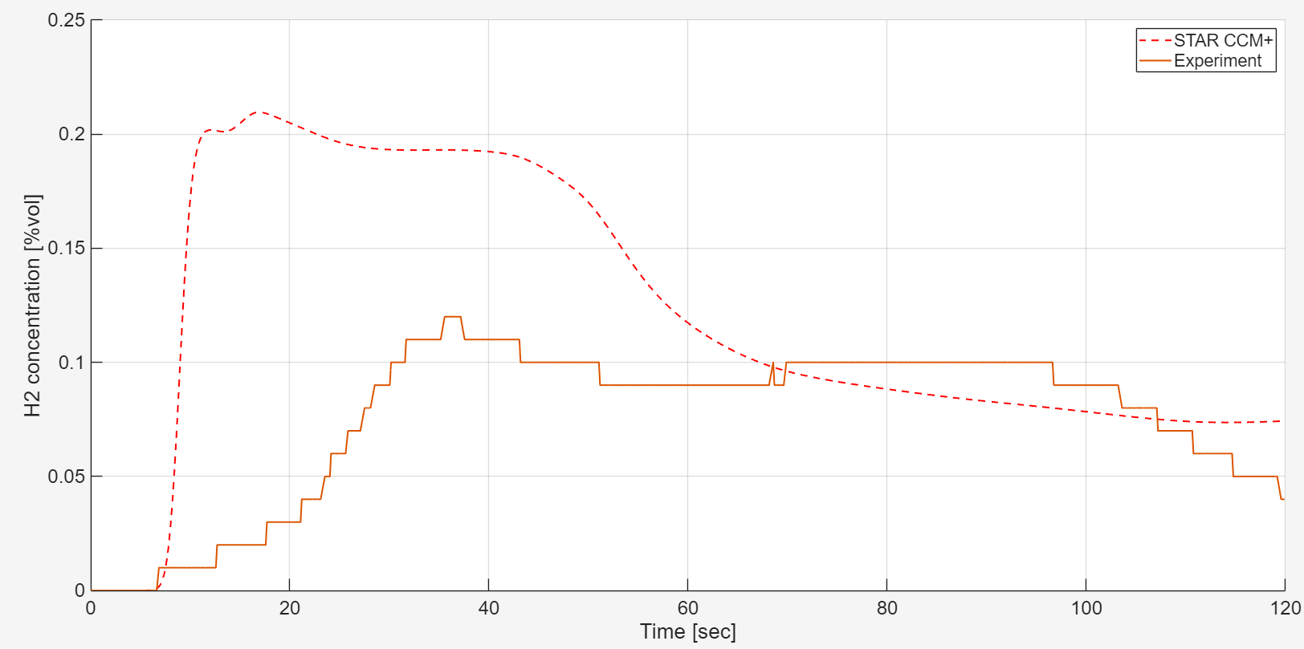
2 ln/min flow sidewards
Notes:
Edit title
Shift according to change in concentration

Slide 16
Key Findings
The simulations are capable to demonstrate the general trends of change in concentration precisely
Due to the low momentum of the hydrogen in all experiments, the effect of different flow or direction is more visible
The scenarios with 2 ln/min flow of hydrogen are providing lesser deviation between the simulations and experiments
Notes:
Can you explain high delay,

Slide 17
Recommendations
Increase the number of repetitions of the experiments to increase accuracy
Conduct experiments and validation for other properties of the hydrogen leakage scenario including small leak opening
Update the workstation PC to run the simulations faster. As an alternative, use external computational servers
Decrease the piping length of the experimental setup
Find a stable and safe way to conduct tests with different flow rates of hydrogen, but equal duration
Notes:
Critical pressure, super sonic speed, uncertainty in physics, challenging to simulate

Slide 18
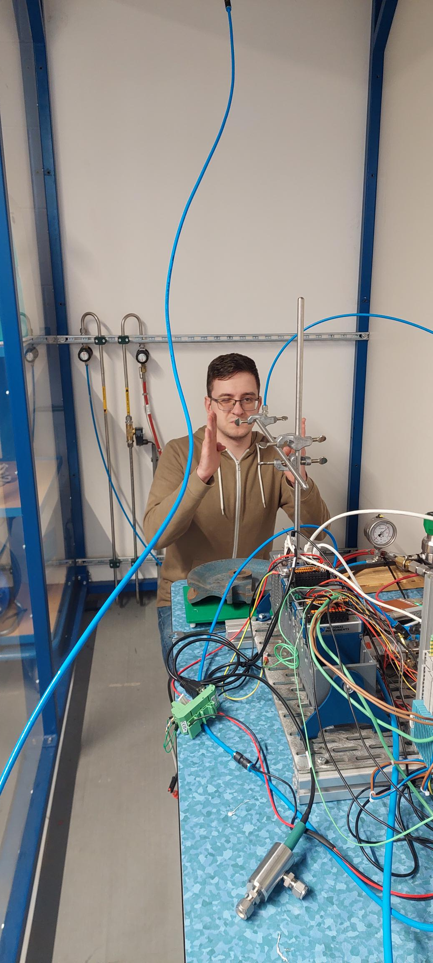

Questions
Contact:
Roel Jansen (Roel.Jansen@han.nl)
Vladislav Kastrov (VN.kastrov@student.han.nl)

