Slide 1


Nera-H2
Hydrogen Fuel Cell River
Cruiser electrical design
and optimization
Reliable Electricity Hubs
Nikola Pozderovic n.pozderovic@student.han.nl
Niels Wissink nj.wissink1@student.han.nl
Lars Foekema ls.foekema@studnet.han.nl
Maryse van de Wiel mmm.vandewiel@student.han.nl
Emad Eddin Al Ahmad ee.alahmad@student.han.nl
Omar Oubiad Altaha o.oubiadaltaha@student.han.nl
Hakan Sagir h.sagir@student.han.nl
Client: NERA-H₂
Supervisor: Miel Stapel
1

Slide 2
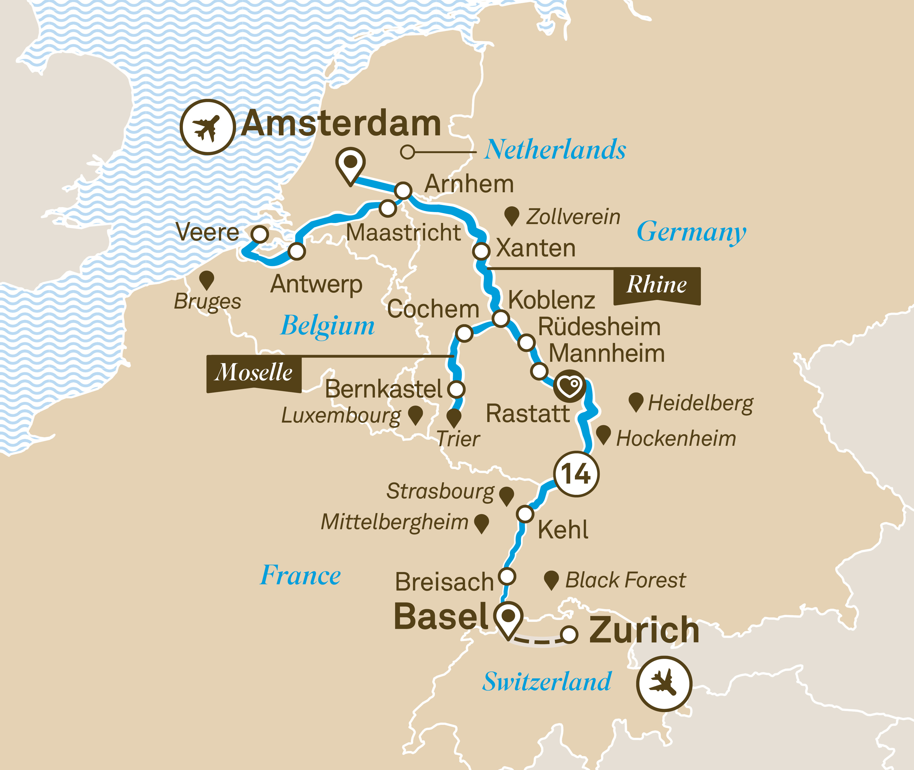
Introduction
Shipping accounts for 2.2% of global CO2 emissions
Regulations from 2030 and 2050 on force change
Opportunities and challenges from diesel to hybrid
  Lower energy density
  Need for EMS
  What kind of hybrid?
  Sizing of fuel cell and battery
Three scenarios
Source: letstalksport
Introduction – Topology – Generators & loads – Results– Discussion & recommendations – Conclusion
2

Slide 3
Project objective
“How can the dynamics of the NERA-H₂ river cruise be analysed, designed and modelled in order to create an EMS that optimally distributes power between fuel cell and battery?”
Introduction – Topology – Generators & loads – Results– Discussion & recommendations – Conclusion
3

Slide 4



Topology
Generator
On-shore charging
Load
Propulsion
StorageUnit
Battery 1
Generator
Refill of hydrogen
3 scenarios
Load
Hotel
StorageUnit
Battery 2
Store
Hydrogen
Link
Fuel cell
Link
Plate Heat. E.
Load
Hotel, heat
Link
Electr. heater
Introduction – Topology – Generators & loads – Results– Discussion & recommendations – Conclusion
5

Slide 5
Waste heat utilisation
Rankine cycle
  13% upper bound, at current operation temperatures
  Complex
  Large
  Costly
Plate heat exchanger
  90% efficiency and higher possible
  Low maintenance
  Relatively small
  Relatively cheap
Introduction – Topology – Generators & loads – Results– Discussion & recommendations – Conclusion
6

Slide 6
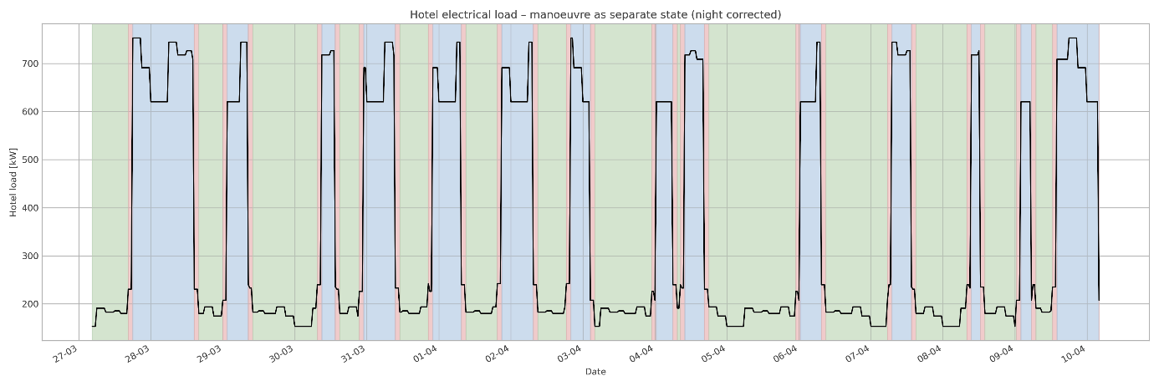
Hotel load and propulsion
Hotel load
Propulsion
  SAIL: vessel is underway between departure and arrival (2x 746 kW)
  MANOEUVRE: a time window of 30 minutes around departure and arrival
  (2x 746 kW + 450 x 0.8 kW)
  PORT: all remaining periods (0 kW)
Introduction – Topology – Generators & loads – Results– Discussion & recommendations – Conclusion
7

Slide 7
Battery system
Charging at every port (10 MW)
Electricity price € 0.30 per kWh
Dual battery system: one to be recharge, one to give power
Charging the electric batteries at 93% efficiency
Discharging the electric batteries at 98% efficiency
Extendable storage and low OPEX
Introduction – Topology – Generators & loads – Results– Discussion & recommendations – Conclusion
8

Slide 8
Fuel cell system
Theoretical background
  Clean electricity (hydrogen fuel)
  Constant power use (ships)
  High cost and integration issues
  Needs batteries for support
Link
Fuel cell 62%
Link
Fuel cell 61%
Price of hydrogen tanks
Price of hydrogen € 0.30 per kWh
Link
Fuel cell 48%
Modelling load dependent efficiency
Power output range kW (difference) | Efficiency [%]
0 – 32 (32) | 62
32 – 50 (18) | 61
50 – 75 (25) | 58
75 – 100 (25) | 56
100 – 125 (25) | 53
125 – 150 (25) | 51
150 – 175 (25) | 48
Max. difference, at max load: 7 [%pt]
Introduction – Topology – Generators & loads – Results– Discussion & recommendations – Conclusion
9
Notes:
FC efficiency
Load dependent efficiency, seperate Links, representing operation range
Links have limit on provided power as is difference in table
Low power, high efficiency loaded first
At most 7 percentage point difference, at max load.

Slide 9
Results
Scenario 2: refill of hydrogen in Amsterdam and Kehl
Source: letstalksport
Introduction – Topology – Generators & loads – Results– Discussion & recommendations – Conclusion
10

Slide 10
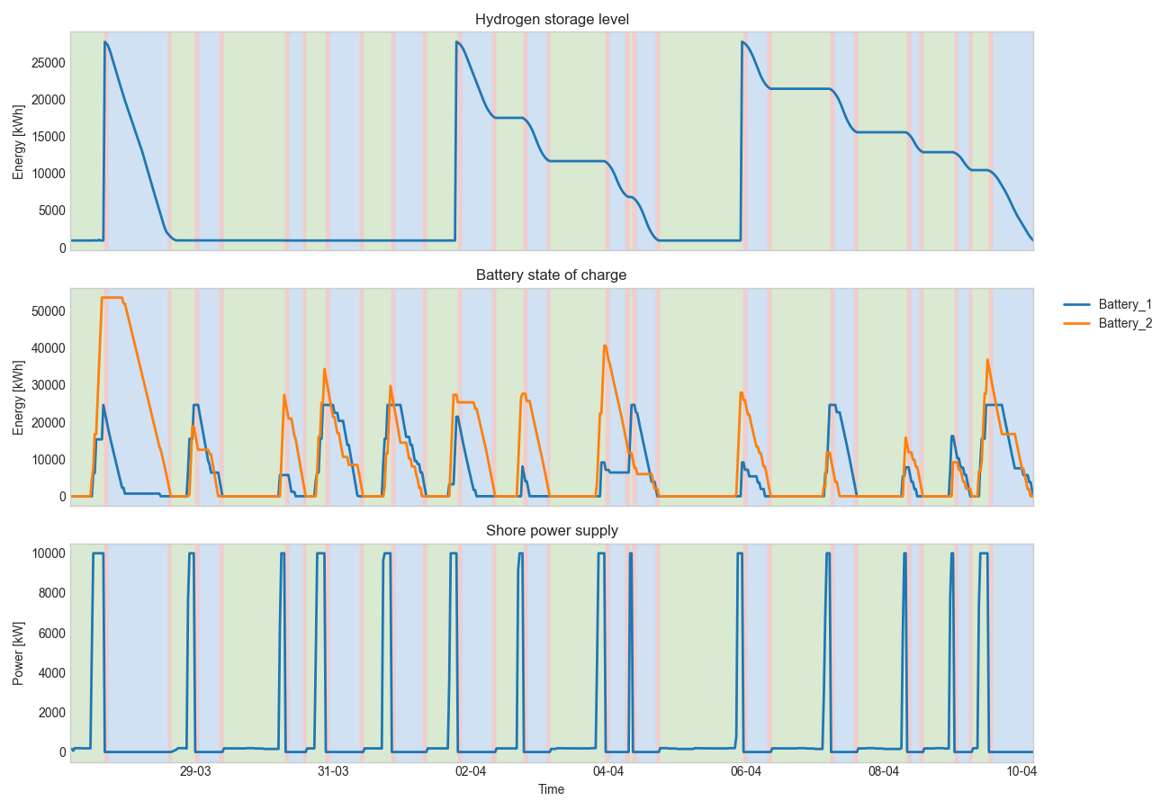
Results
Introduction – Topology – Generators & loads – Results– Discussion & recommendations – Conclusion
11

Slide 11
Results
Introduction – Topology – Generators & loads – Results– Discussion & recommendations – Conclusion
11

Slide 12
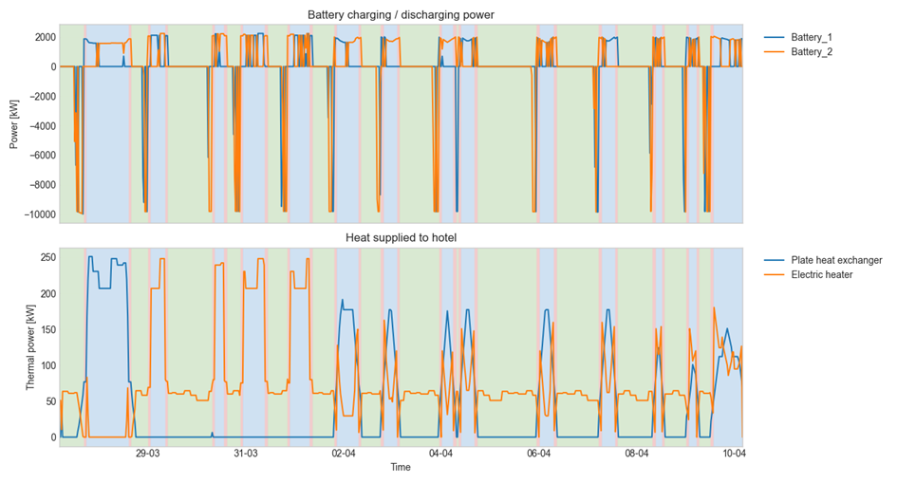
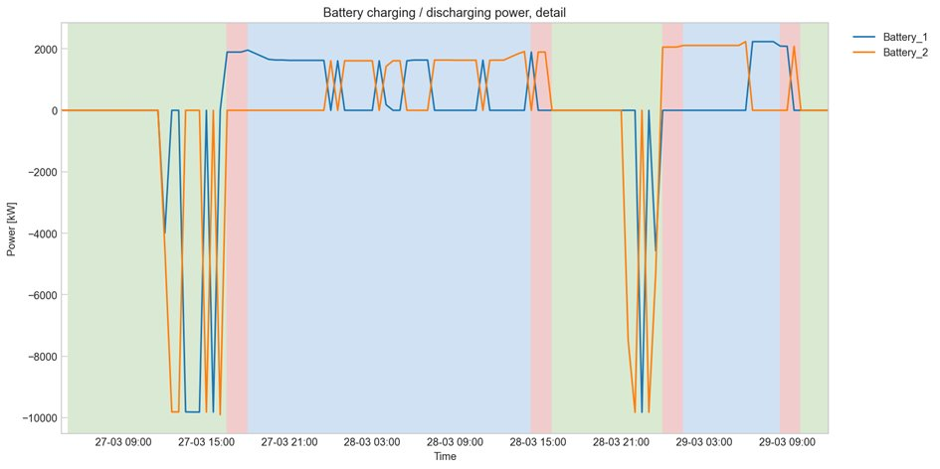
Results
Introduction – Topology – Generators & loads – Results– Discussion & recommendations – Conclusion
12

Slide 13
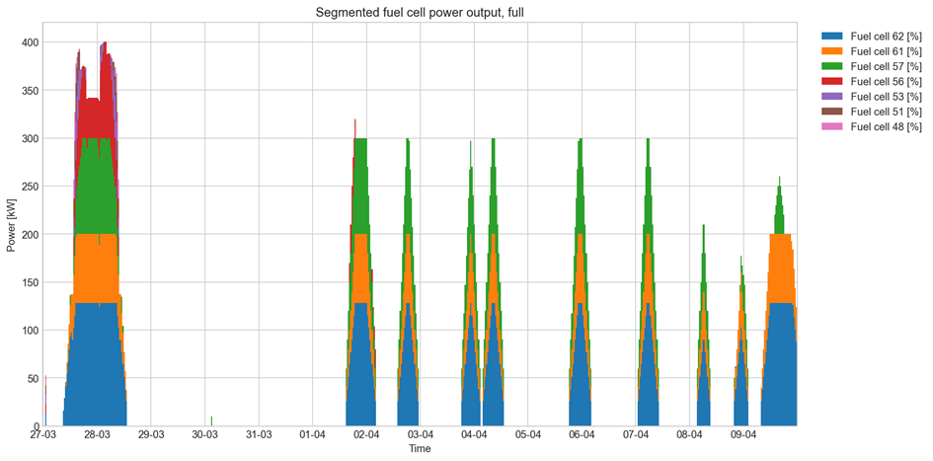
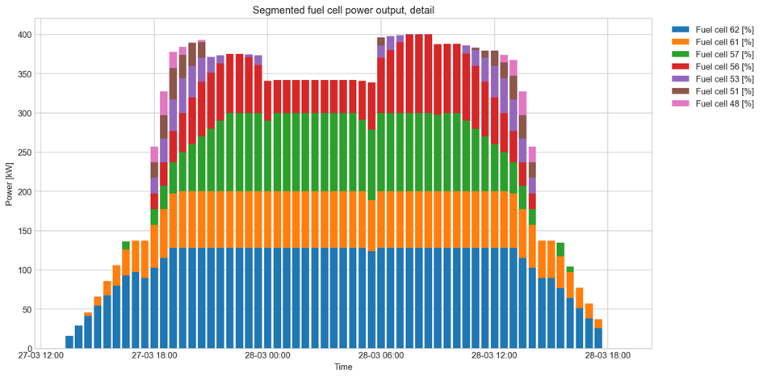
Results
Introduction – Topology – Generators & loads – Results– Discussion & recommendations – Conclusion
13

Slide 14
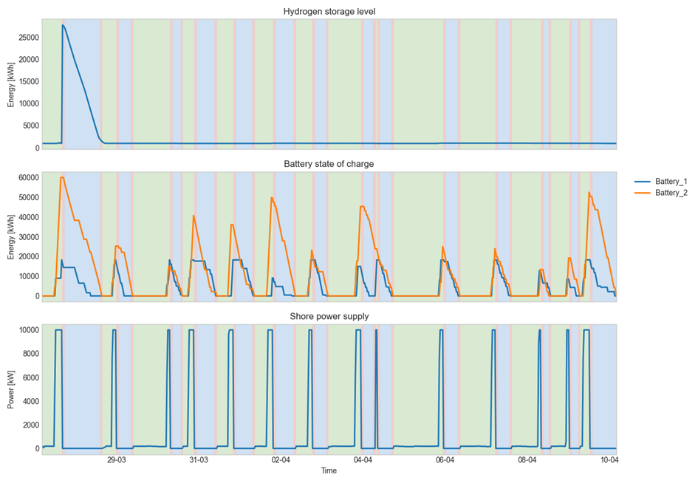
Influence of high hydrogen price
Hydrogen price +10%
Introduction – Topology – Generators & loads – Results– Discussion & recommendations – Conclusion
14
Notes:
Battery size: 80.000 kWh

Slide 15
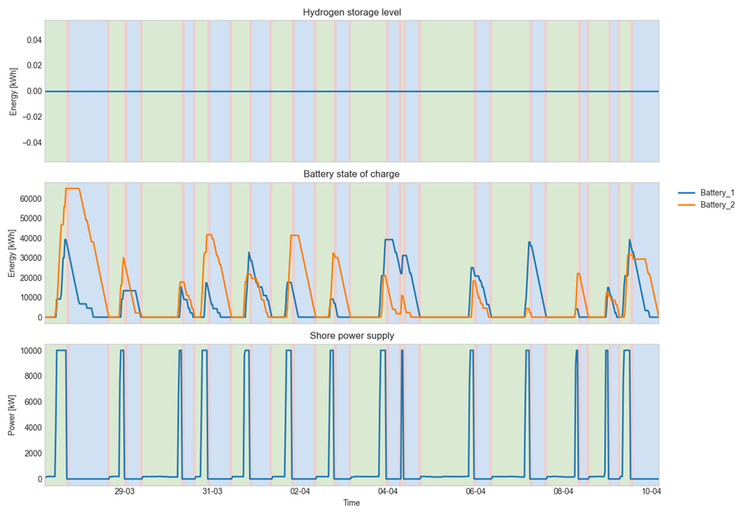
Influence of low battery price
Battery price -90%
Introduction – Topology – Generators & loads – Results– Discussion & recommendations – Conclusion
15
Notes:
Battery size: 120.000 kWh

Slide 16
Sizing and pricing
Component | Power output [kW] | Capacity [kWh]
Battery system | 2 x 10.000 | 80.000
Fuel cell system | 4 x 150 | 30.000
Scenario of hydrogen refuelling | Price in euro
1: Amsterdam | 1.330.000
2: Amsterdam and Kehl | 1.320.000
3: Every Port | 1.320.000
Battery size has a minimum with current fuel cell conditions
Hydrogen application varies with fuel prices from 0 to 50.000 kWh capacity on board
Introduction – Topology – Generators & loads – Results– Discussion & recommendations – Conclusion
16

Slide 17
Discussion & recommendations
Clear hydrogen- and electricity pricing
Implement measured data to improve reliability load profile
On board limitations
  Size
  Safety
Fuel cell constraints investigated in more detail
Separate AC and DC busses
One battery
PyPSA limitations
  Static values
  Values changing over time
  Limitations in ramps
Introduction – Topology – Generators & loads – Results– Discussion & recommendations – Conclusion
17
Notes:
Hydrogen- electricity pricing
Pricing can vary from port to port. Now static.
Measured data
Load profile is currently estimated. Measured data can be used to generate actual load profile.
FC constraints
Actual behavior of FC is not realistic. Research required to make more realistic.
AC DC busses
Currently is all and one electricity bus. Disadvantage: losses and costs for conversion are not implemented.
One battery
Next slide.
On board limitations
Actual size and safety is not yet considered
PyPSA limitations
PyPSA only works with static values, or with values changing over time
Limitations in ramps (next slide)

Slide 18
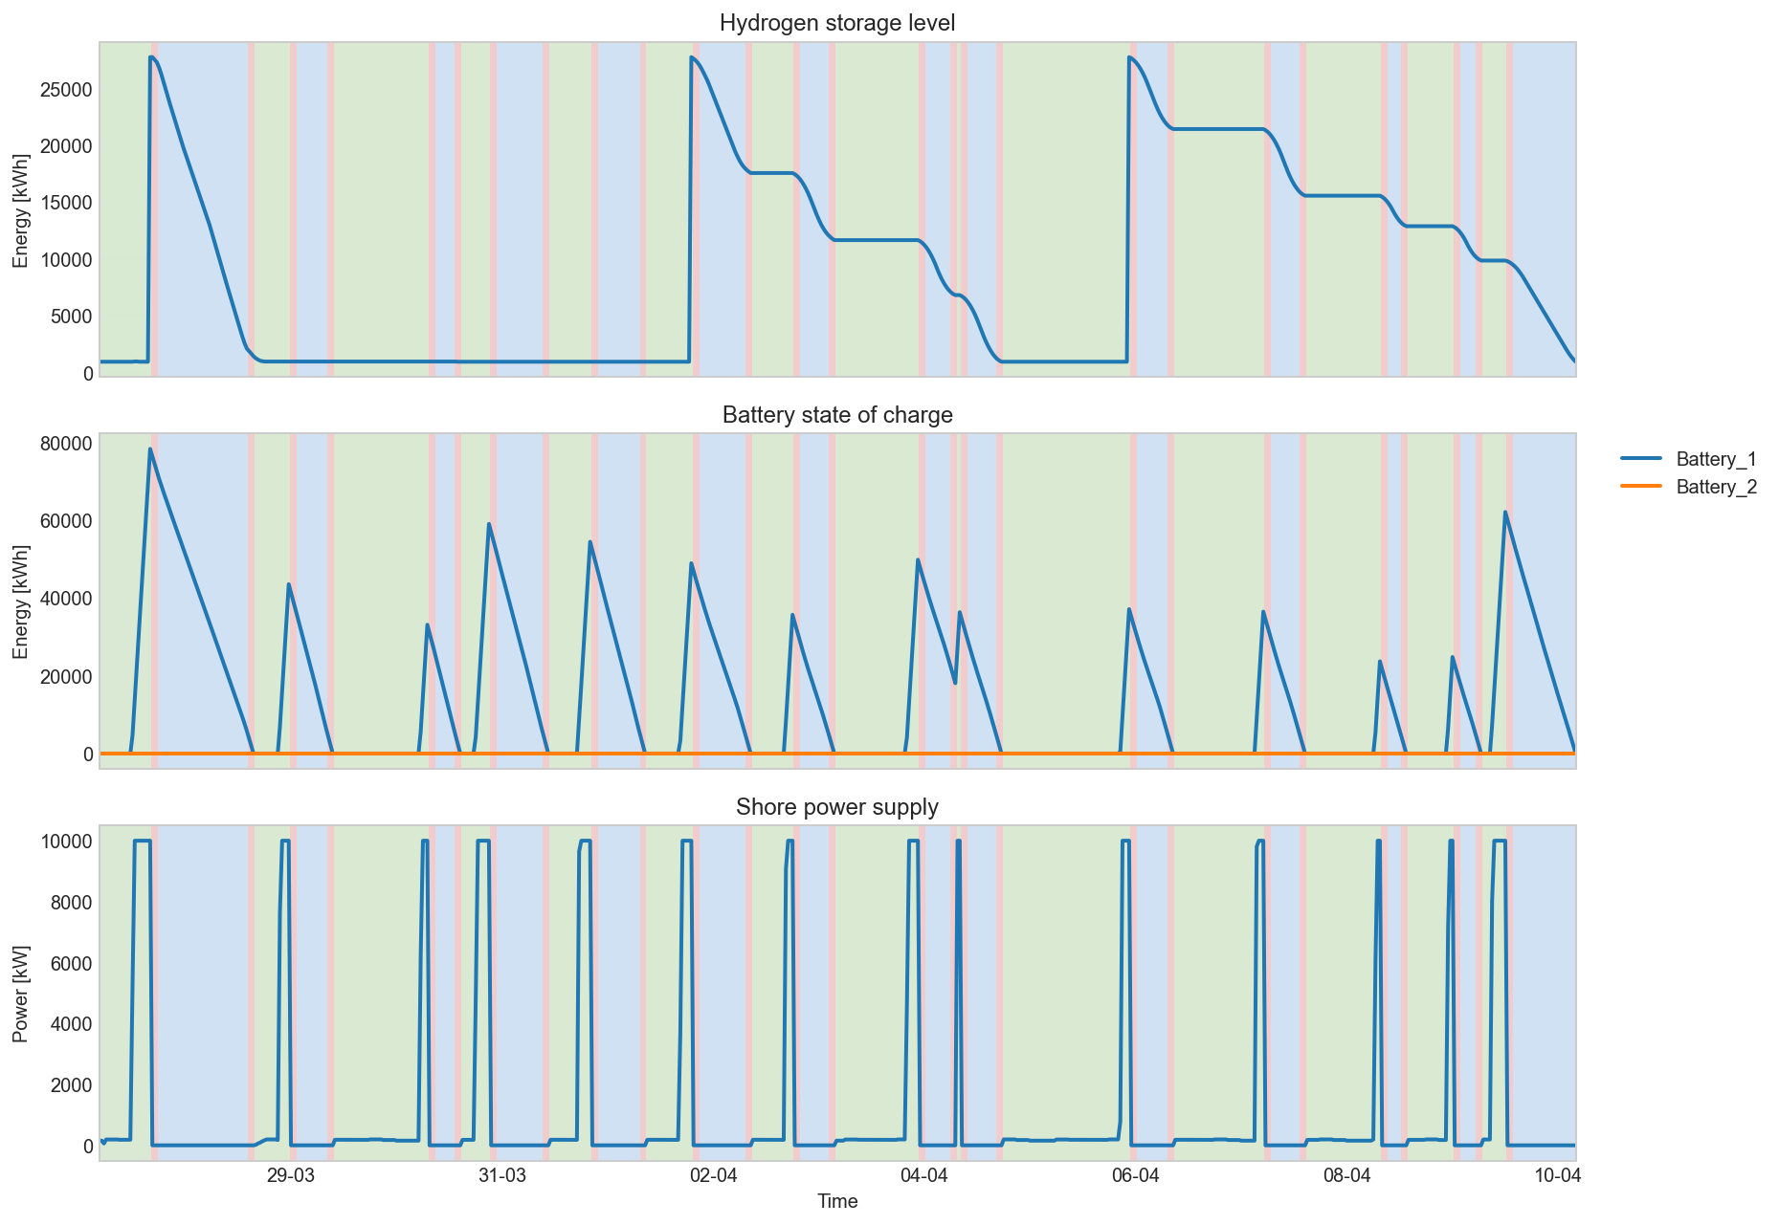
Discussion & recommendations
Clear hydrogen- and electricity pricing
Implement measured data to improve reliability load profile
On board limitations
  Size
  Safety
Fuel cell constraints investigated in more detail
Separate AC and DC busses
One battery
PyPSA limitations
  Static values
  Values changing over time
  Limitations in ramps
Introduction – Topology – Generators & loads – Results– Discussion & recommendations – Conclusion

Slide 19
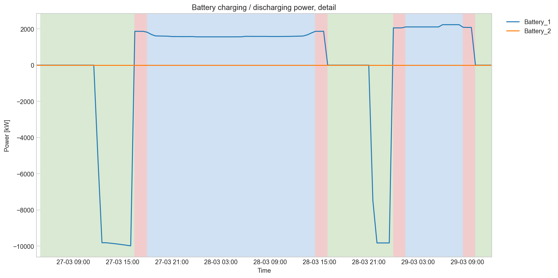
Discussion & recommendations
Clear hydrogen- and electricity pricing
Implement measured data to improve reliability load profile
On board limitations
  Size
  Safety
Fuel cell constraints investigated in more detail
Separate AC and DC busses
One battery
PyPSA limitations
  Static values
  Values changing over time
  Limitations in ramps
19
Introduction – Topology – Generators & loads – Results– Discussion & recommendations – Conclusion
8

Slide 20
Discussion & recommendations
Clear hydrogen- and electricity pricing
Implement measured data to improve reliability load profile
On board limitations
  Size
  Safety
Fuel cell constraints investigated in more detail
Separate AC and DC busses
One battery
PyPSA limitations
  Static values
  Values changing over time
  Limitations in ramps
Introduction – Topology – Generators & loads – Results– Discussion & recommendations – Conclusion
20

Slide 21
Conclusion
Waste heat utilisation through plate heat exchanger
Hybrid system is feasible, but
  Battery has minimum size -> too big
  Validation data needed
  Further modelling to be done
  Assign price per square meter or weight
Recommended battery energy capacity is 80.000 kWh -> too heavy
Recommended hydrogen storage is 30.000 kWh
Four fuel cells of type Zepp x.150 are recommended
Total annual costs are €1.320.000
Introduction – Topology – Generators & loads – Results– Discussion & recommendations – Conclusion
21
Notes:
Fuel cell not necessary with current constraints
Constraints in terms of sizing on ship

Slide 22

Questions?

