Slide 1


Power-to-Methanol:
Green methanol as an energy carrier and chemical building block
Hans Gelten
HAN H2 EVENT, Arnhem, 2026-01-30

Slide 2
Green methanol as an energy carrier and chemical building block
Professional Doctorate project
Techno-Economic Analysis: a dynamic and integrated energy/process challenge
Development of the lab-scale methanol set-up

Slide 3
Power-to-Methanol:
Professional Doctorate project

Slide 4
Investing energy in hydrogen – accelerating applications of decentralised hydrogen
Part of a Professional Doctorate project (PhD position at Universities of Applied Science), running from feb 2024 – feb 2028
The Professional Doctorate project deals with the complex challenges and strategic goals related to energy, sustainability, and circularity, focusing on the transition towards green energy and the role of hydrogen in addressing these challenges.
Part of the research group Sustainable Energy Systems (professor Richard van Leeuwen)

Slide 5

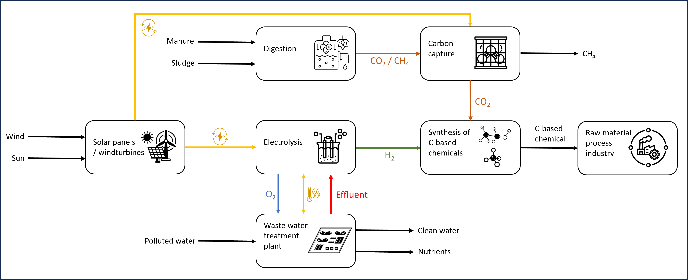
Value chain of hydrogen – Sustainable Methanol production

Slide 6
Power-to-Methanol:
Techno-Economic Analysis: a dynamic and integrated energy/process challenge

Slide 7
Dynamic and optimized TEA – background (1)
The involved Power-to-MeOH processes:
CO₂ hydrogenation to MeOH
Dry methane reforming of biogas to syngas and converted to MeOH
Biomethane decomposition to hydrogen, followed with CO₂ hydrogenation
The Techno-Economic Analysis (TEA) is carried out following the methodology of Turton.
ASPEN Plus software is used for (static) simulation of processes

Slide 8
Dynamic and optimized TEA – background (2)
OptiPlant is used to build and operate an integrated energy-chemical system at minimum cost (developed at DTU in Denmark).
This approach results in:
A static TEA to compare processes – intermittency or energy prices are neglected
Optimized TEA integrating energy, processes, intermittency and economics

Slide 9
Results static & dynamic TEA – levelised cost of MeOH
Benchmark: Fossil based MeOH 530 €/ton
Central e-MeOH 1,080 €/ton
Processes: MeOH from CCU 2,186 €/ton
MeOH from DMR 2,372 €/ton
MeOH from MD 1,865 €/ton
Optimized with Optiplant: MeOH from CCU 1,501 €/ton
MeOH from DMR 2,004 €/ton
MeOH from MD 1,890 €/ton

Slide 10
Power-to-Methanol:
Development of the lab-scale methanol set-up

Slide 11
Reason and starting point
The performance of a Methanol reactor can be predicted using simulation software like Comsol.
COMSOL is a general-purpose simulation software package used for modeling and simulating designs, devices, and processes across various fields of engineering and science.

Slide 12
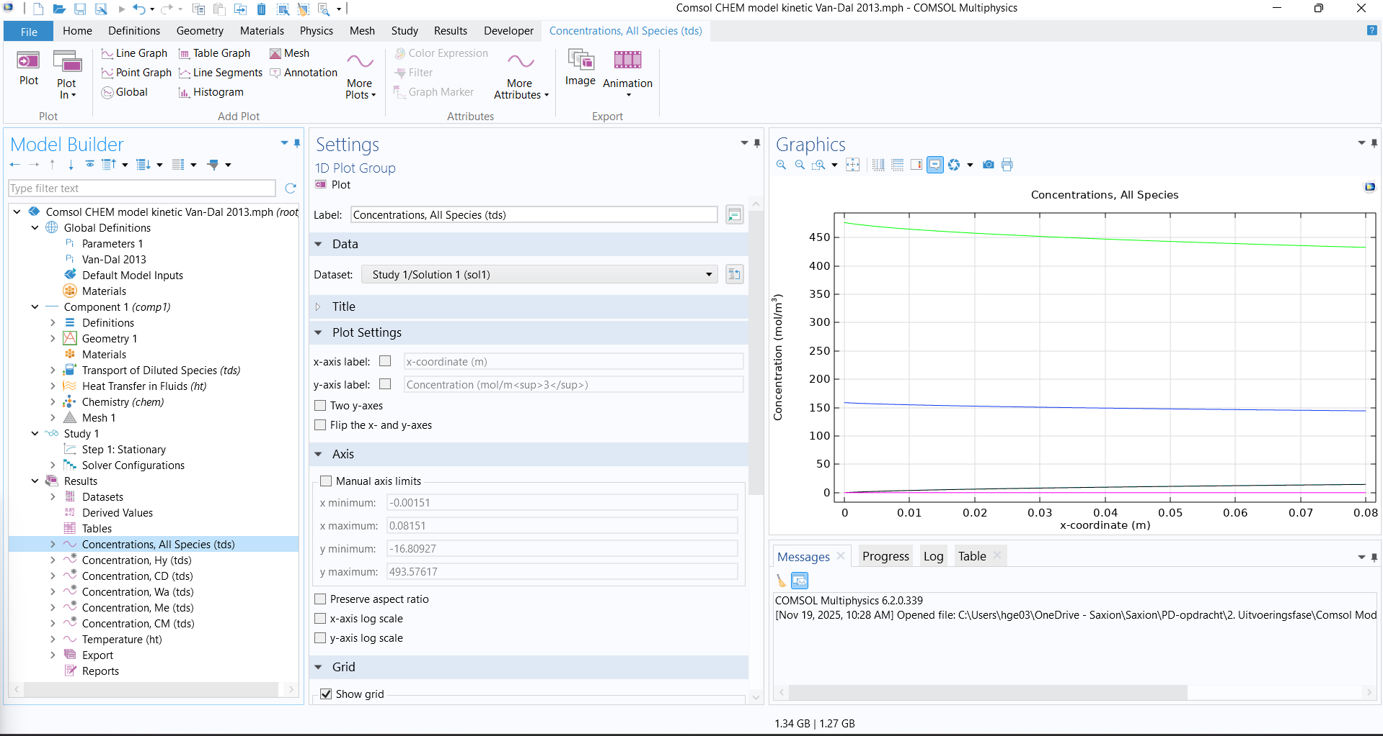

Slide 13
Reason and starting point
Research carried out by Vera Keijzer (BSc. graduation, Feb-Jul 2025).
A labscale process can be used as validation tool for Comsol.
Starting point is the Methanol set-up developed at HAN University of Applied Science.

Slide 14
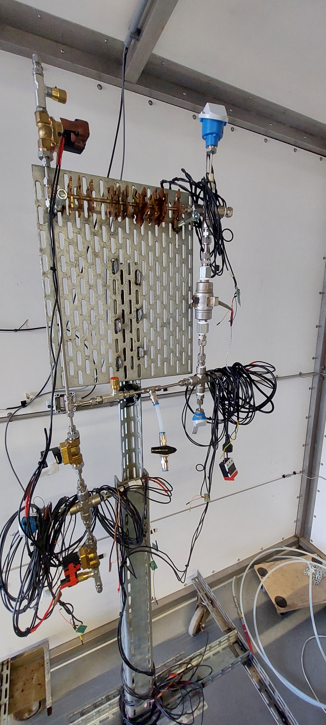
Methanol set-up at HAN

Slide 15
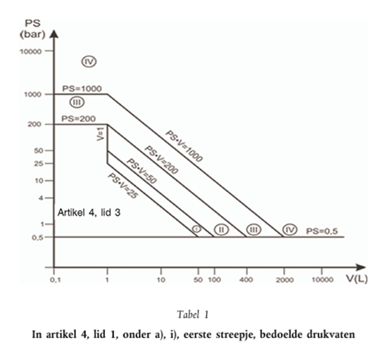
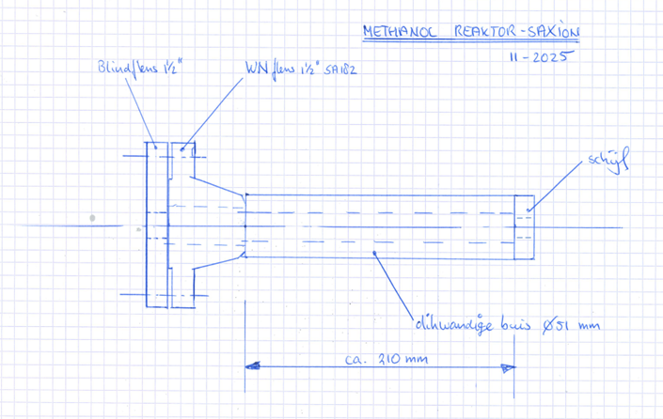
Development @ Saxion University of Applied Science
Adjustments to the set-up:
Single pass process
Continuous process
Adapted for high pressure
Equiped with pressure vessel

Slide 16
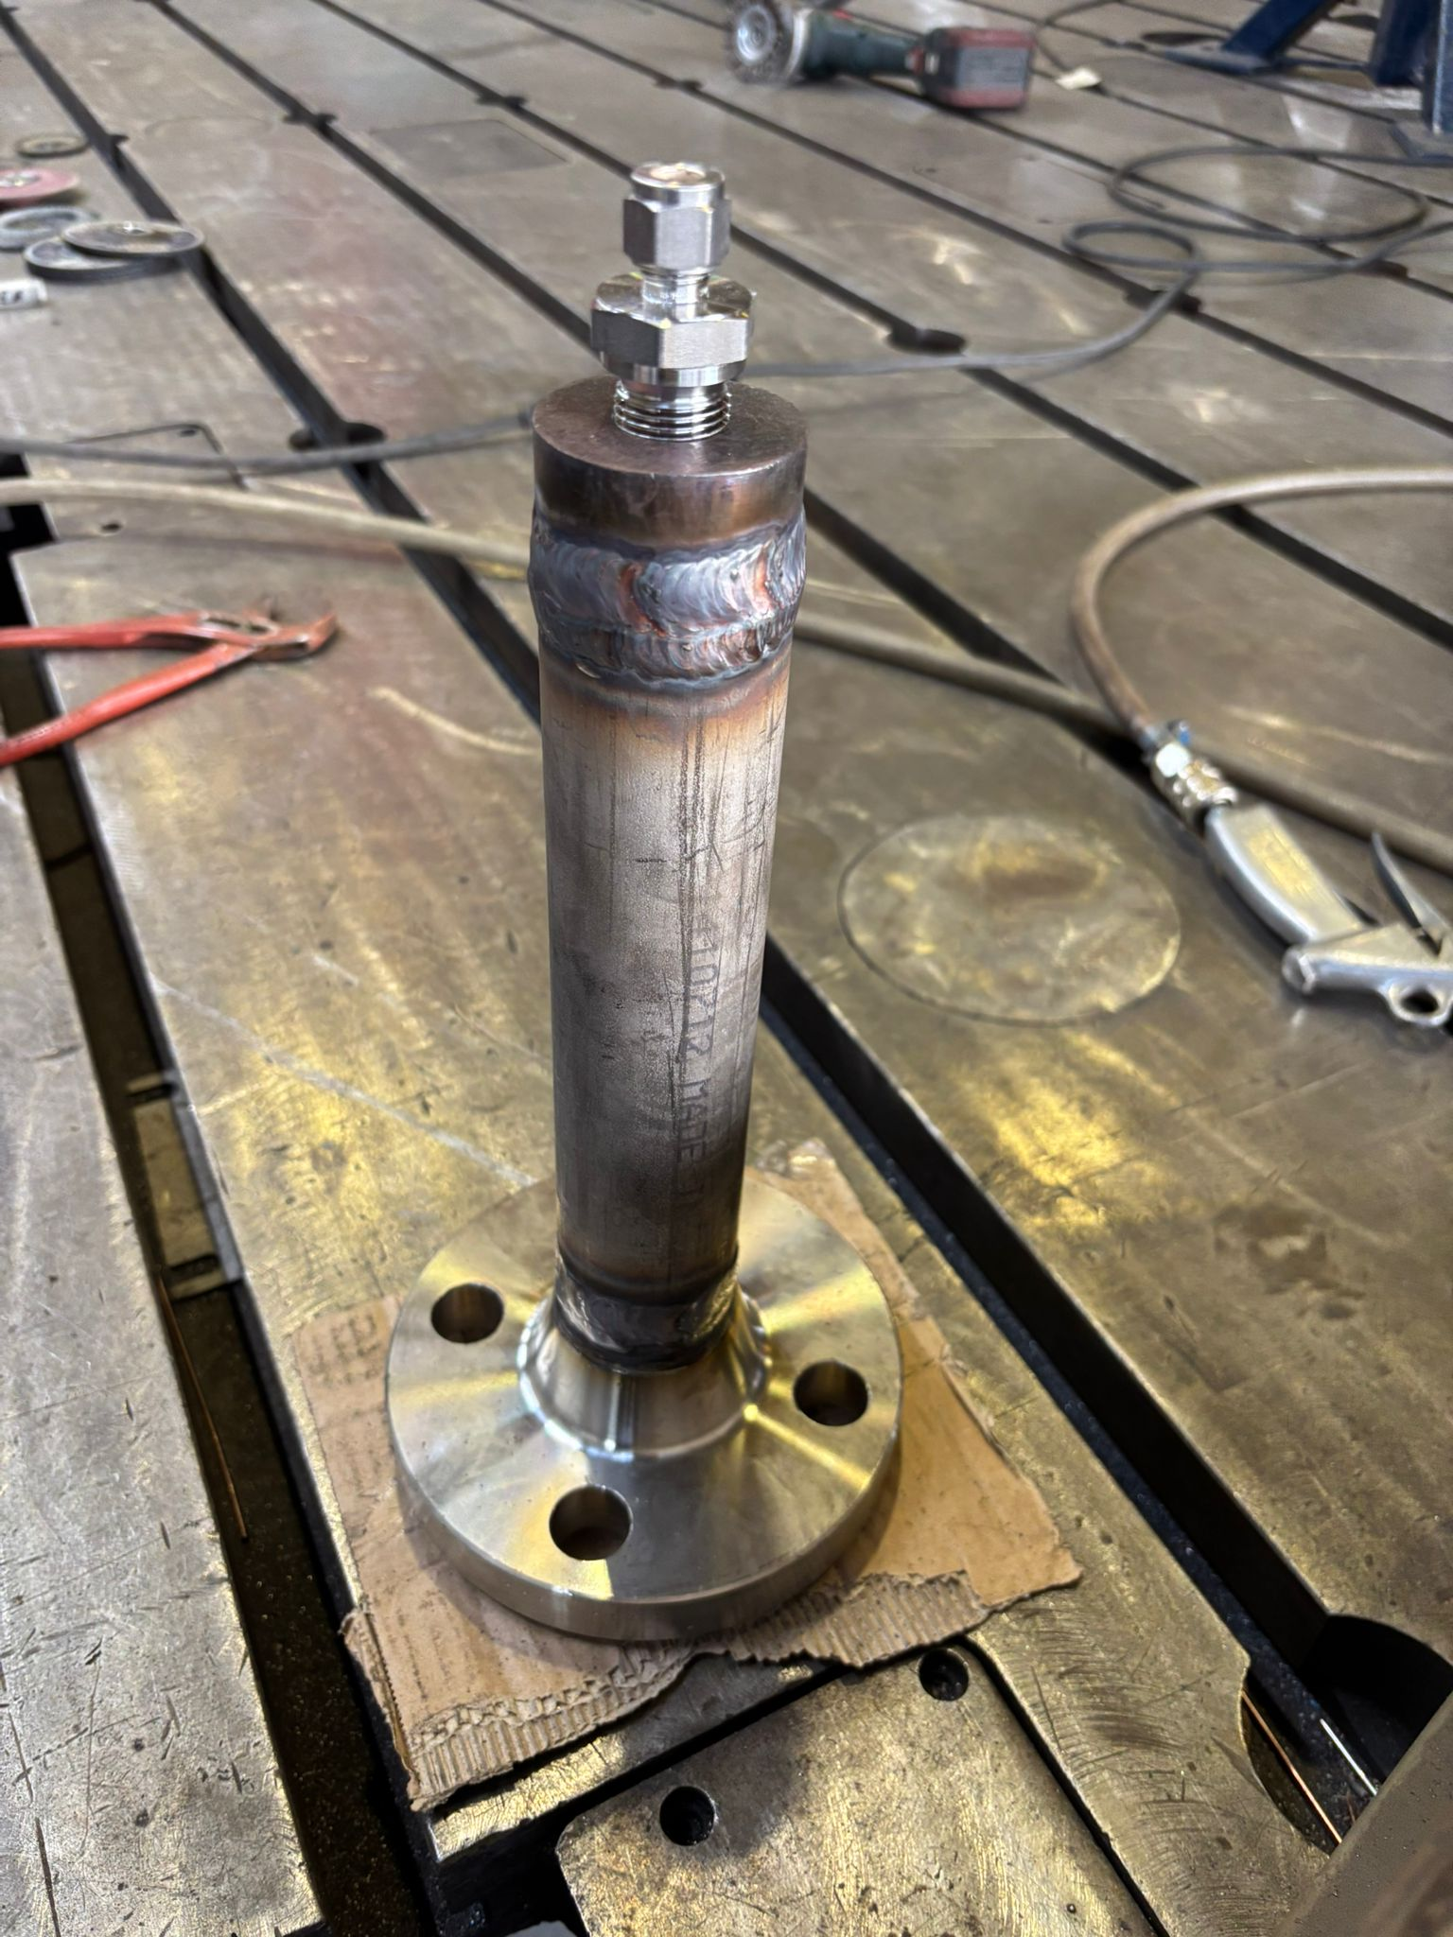
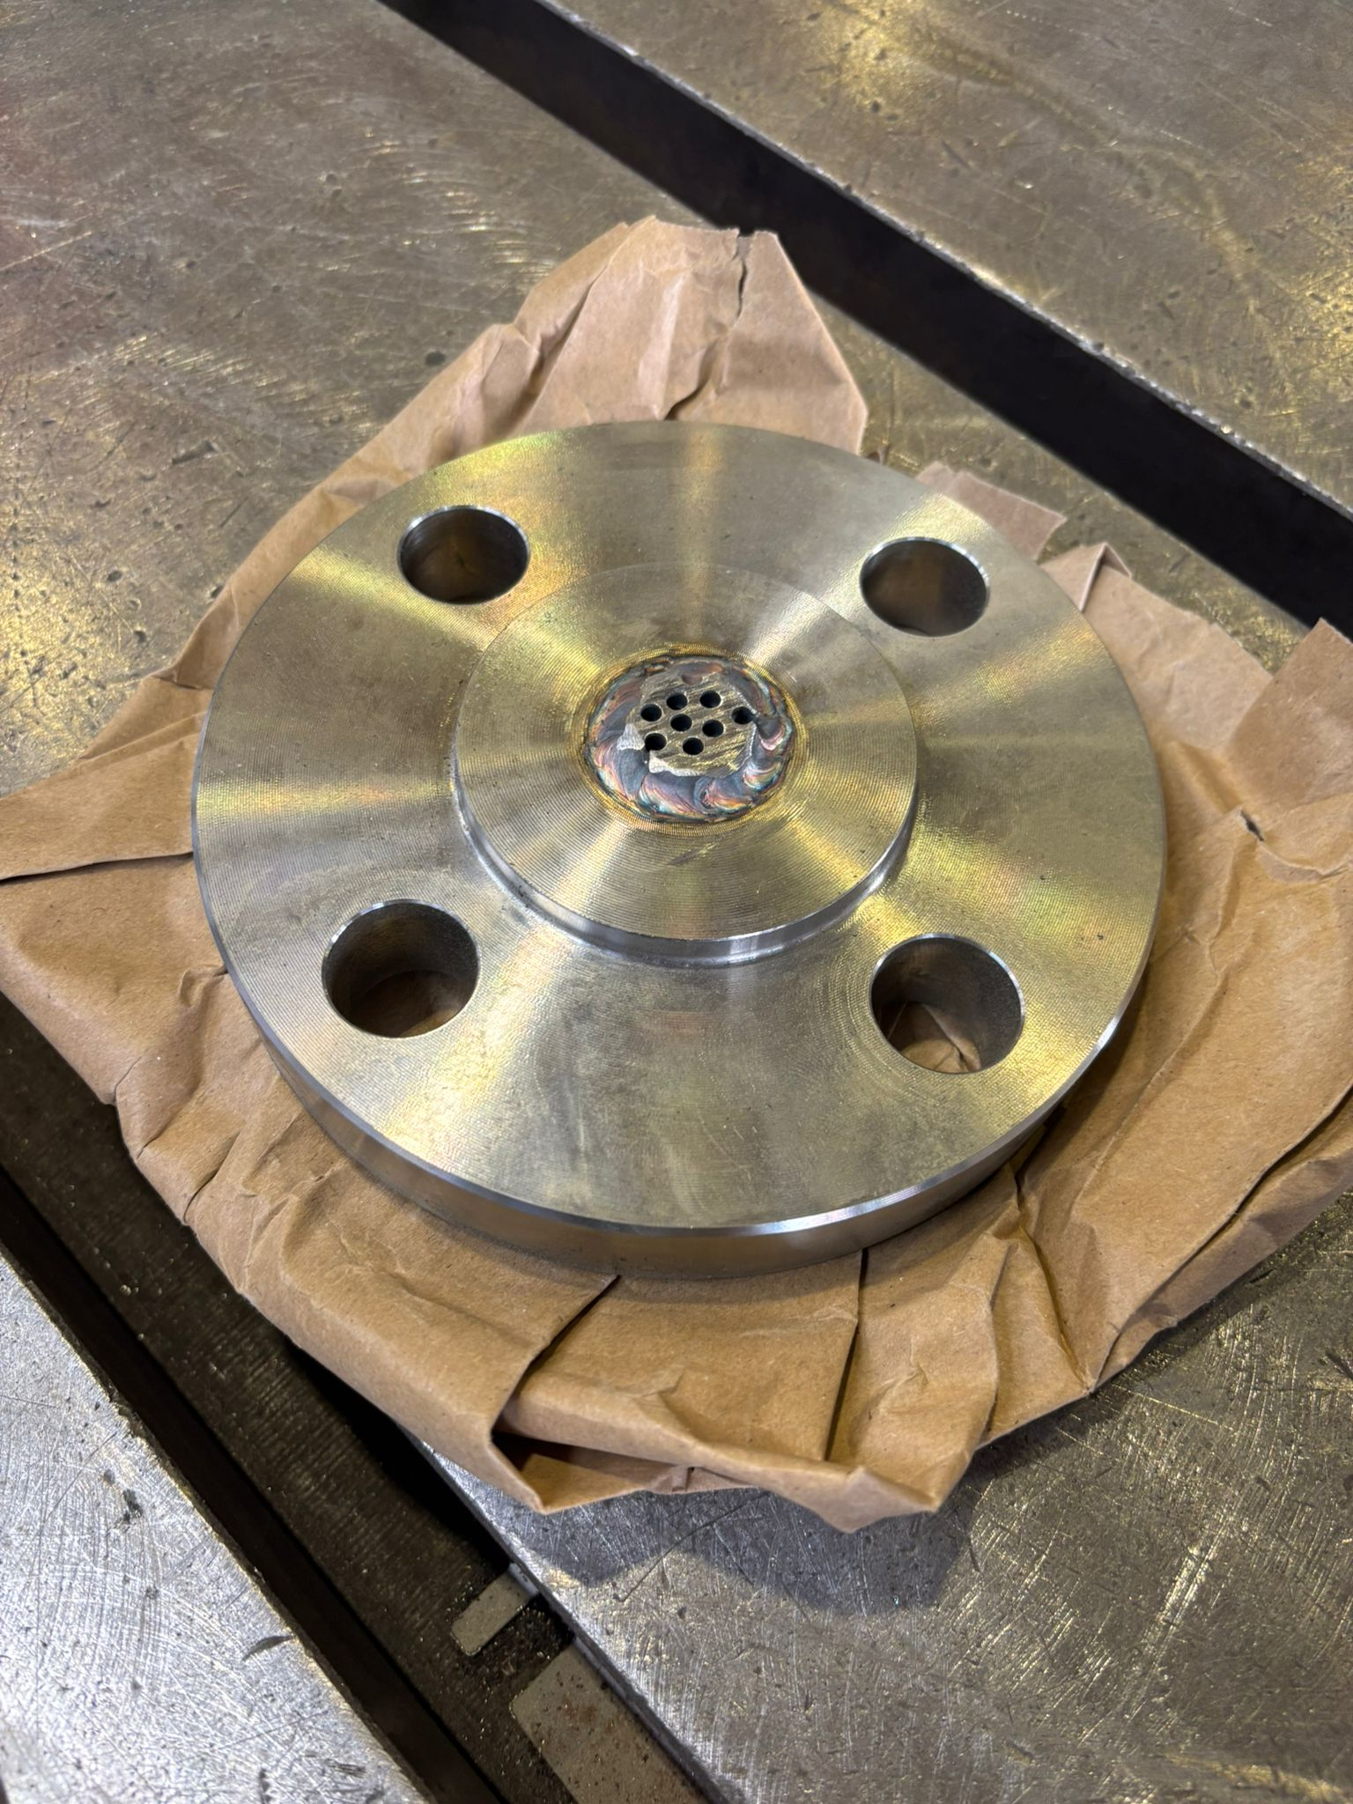
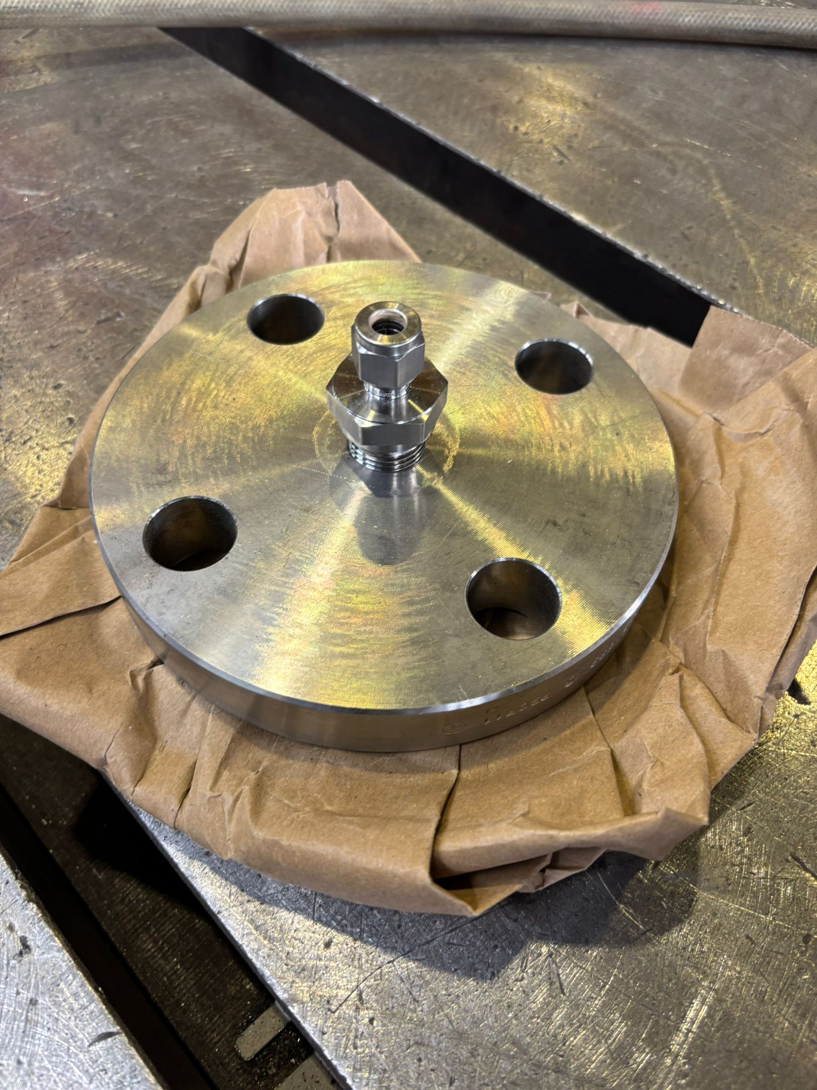
Pressure vessel (in cooperation with Boessenkool)

Slide 17
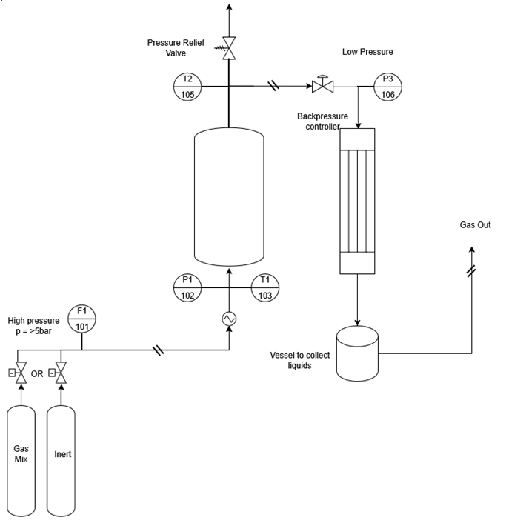
The set-up
Process Flow Diagram:
Temperature to 200 °C
Pressure to 50 bar
Stoichiometric gas mixture (CO₂/H₂)
Gas and liquid product/reactants
Research carried out by Ivo Jeeninga
(BSc. graduation, Sep-Jan 2026).

Slide 18

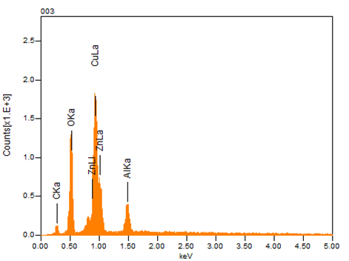

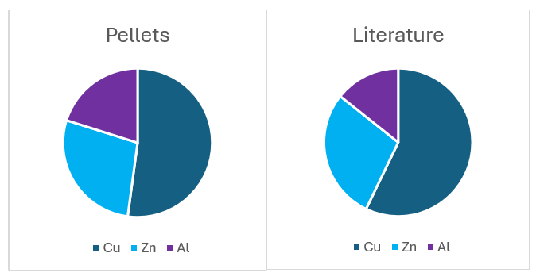
Catalyst characterization
Catalyst material (Cu/ZnO-Al₂O₃) is used from HAN
SEM-EDX is used for characterization of pellets

Slide 19
Current status
Construction of framework, set-up and sensors
Start of leaktesting and test experiments
Ongoing research from Feb – Jul 2026 (Jonathan Wolters (internship) and Mart Oelering)

Slide 20

Thank you for your kind attention!
More information:
Hans Gelten
j.a.p.gelten@saxion.nl / 0610823289

